Slide 1
Benefits and Drawbacks of Social Media
Presented By:
Huzaifa (25L-0700) Shaaf (25L-0812) Zainab Ali (25L-0801) Ali Haziq (25L-0686)

Slide 2
Presentation Outlines
Introduction
Conclusion
Ways : How to Use It
Drawbacks and
negative effects
Benefits of Social Media

Slide 3
Presentation Outlines
Introduction
Benefits of Social Media
Drawbacks and
negative effects
Ways : How to Use It
Conclusion

Slide 4
Introduction to Social Media
Social media is a digital space where people connect, share information and communicate instantly , becoming an essential part of daily life for millions around the world .
Used for communication and content sharing
Used for messaging , entertainment , news and learning
Includes popular apps like Instagram , TikTok , YouTube and X
Influences how people express themselves and stay informed
Plays a major role in shaping modern communication habits
Connect with friends and family

Slide 5
Benefits of Social Media
Instant Communication
Awareness and Social Movements
Educational Resources
Creativity and Self Expression
Business and Marketing
Opportunities

Slide 6
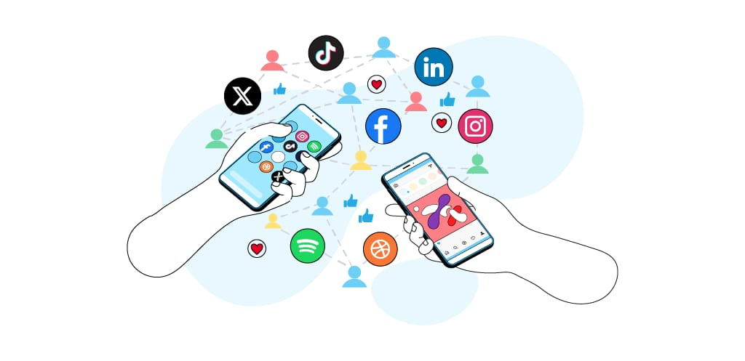
Drawbacks and Negative Effects
Addiction and Excessive screen time
Cyberbullying and Online Harassment
Privacy Risks and Misinformation
Mental Health Effects: Comparison, Low Self-Esteem
Reduced in-person Social Interaction

Slide 7
Ways to Use Social Media Responsibly
Using social media responsibly helps reduce risks like addiction and misinformation, allowing people to enjoy its benefits while maintaining safety, balance, and well-being
Set Time limits to avoid overuse
Verify information before sharing
Protect privacy by adjusting account settings
Engage respectfully
Avoid harmful content
Follow accounts that promote positivity and Learning.

Slide 8
Conclusion
To conclude, like everything else, social media also poses both benefits and threats to one. Its impact on us as a society is entirely dependent on us. It can be both a powerful tool offering great resources and a dangerous weapon creating harm. Hence, it should be used mindfully.

